Slide 1
How Western Science is Leaving Room for Faith in How the University Works
By Jim Graham

Slide 2
Contents
1000^{N} Scale
Energy
Fabric of Space
Quarks
The Big Bang
Matter
Atoms
Forces
  Strong Force
  Weak Force
  Electromagnetism
  Gravity
  Energy repulsion
Time

Slide 3
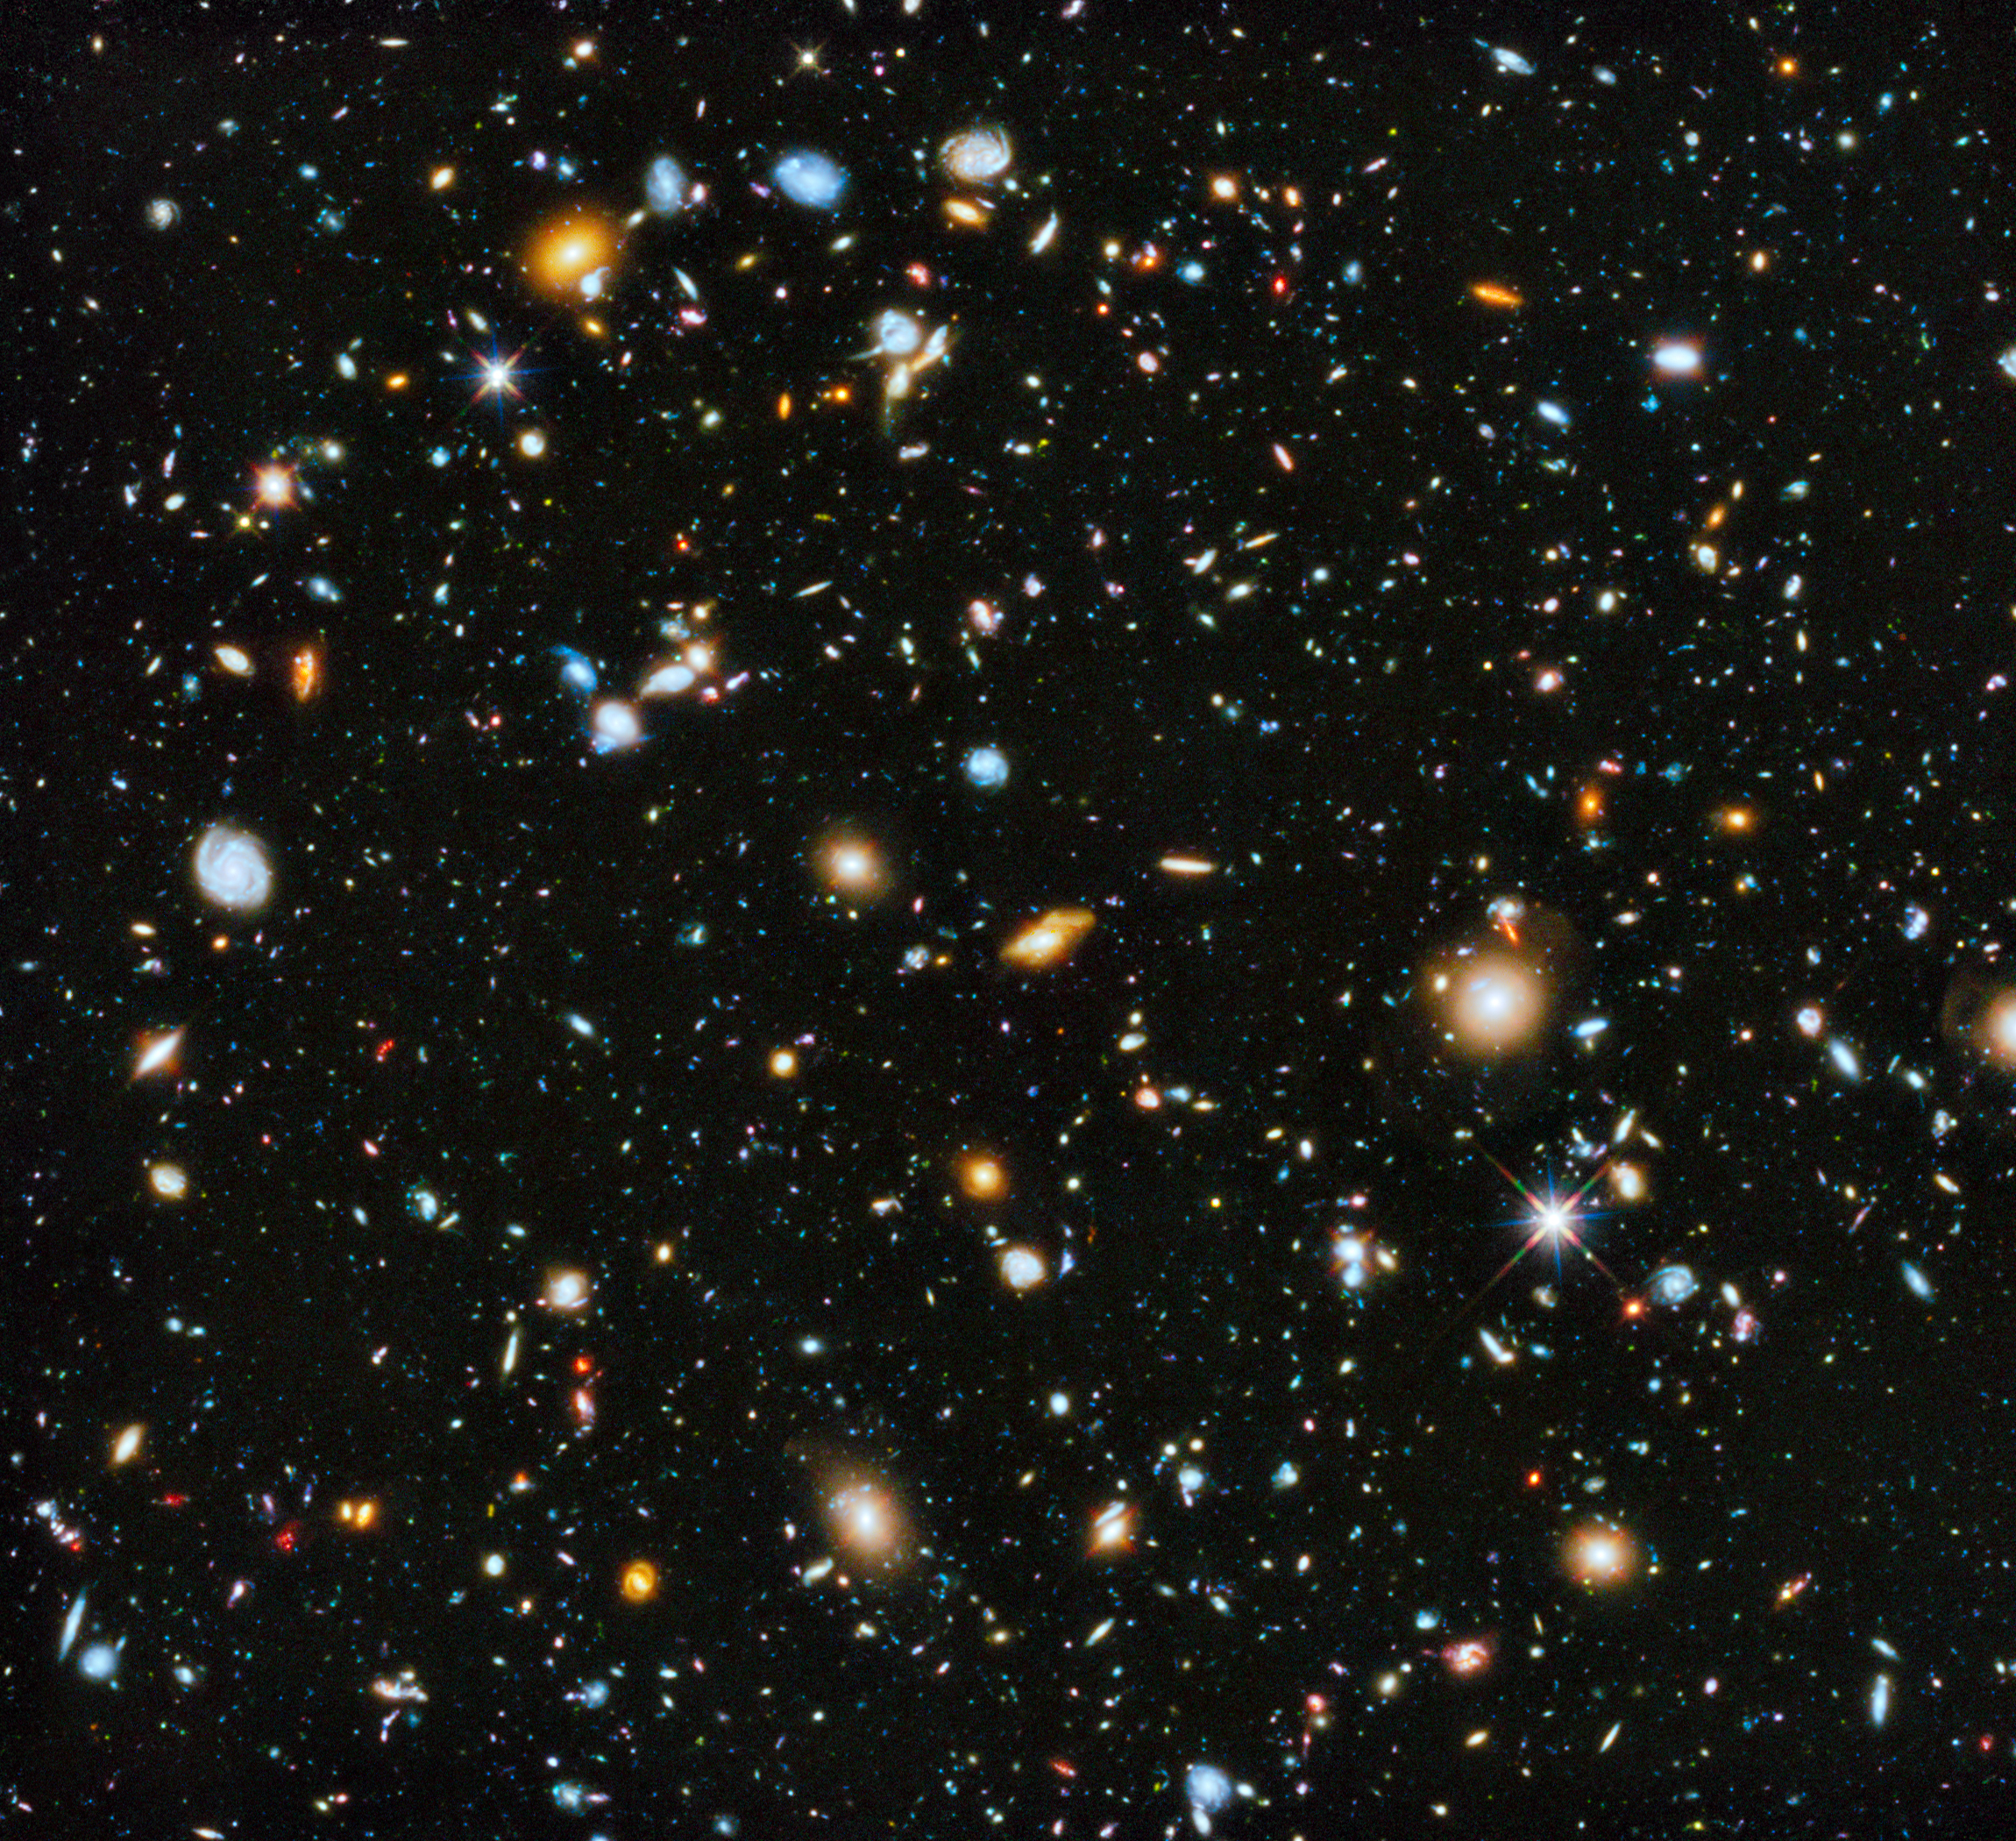
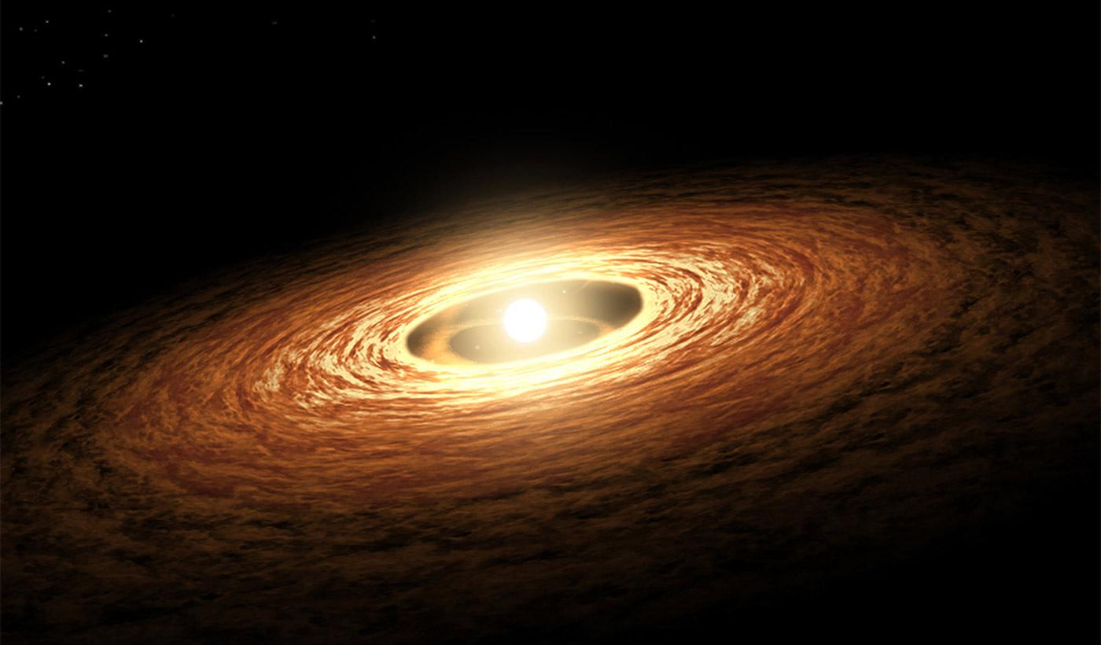
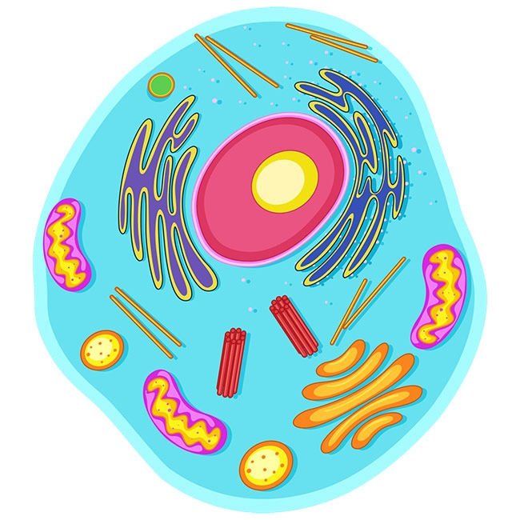
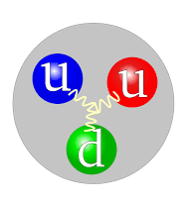
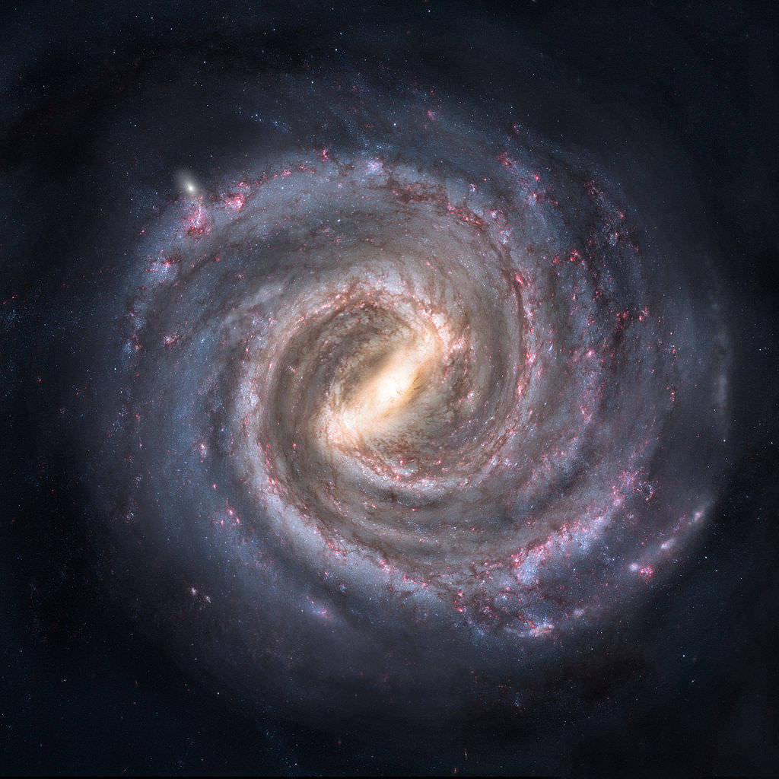
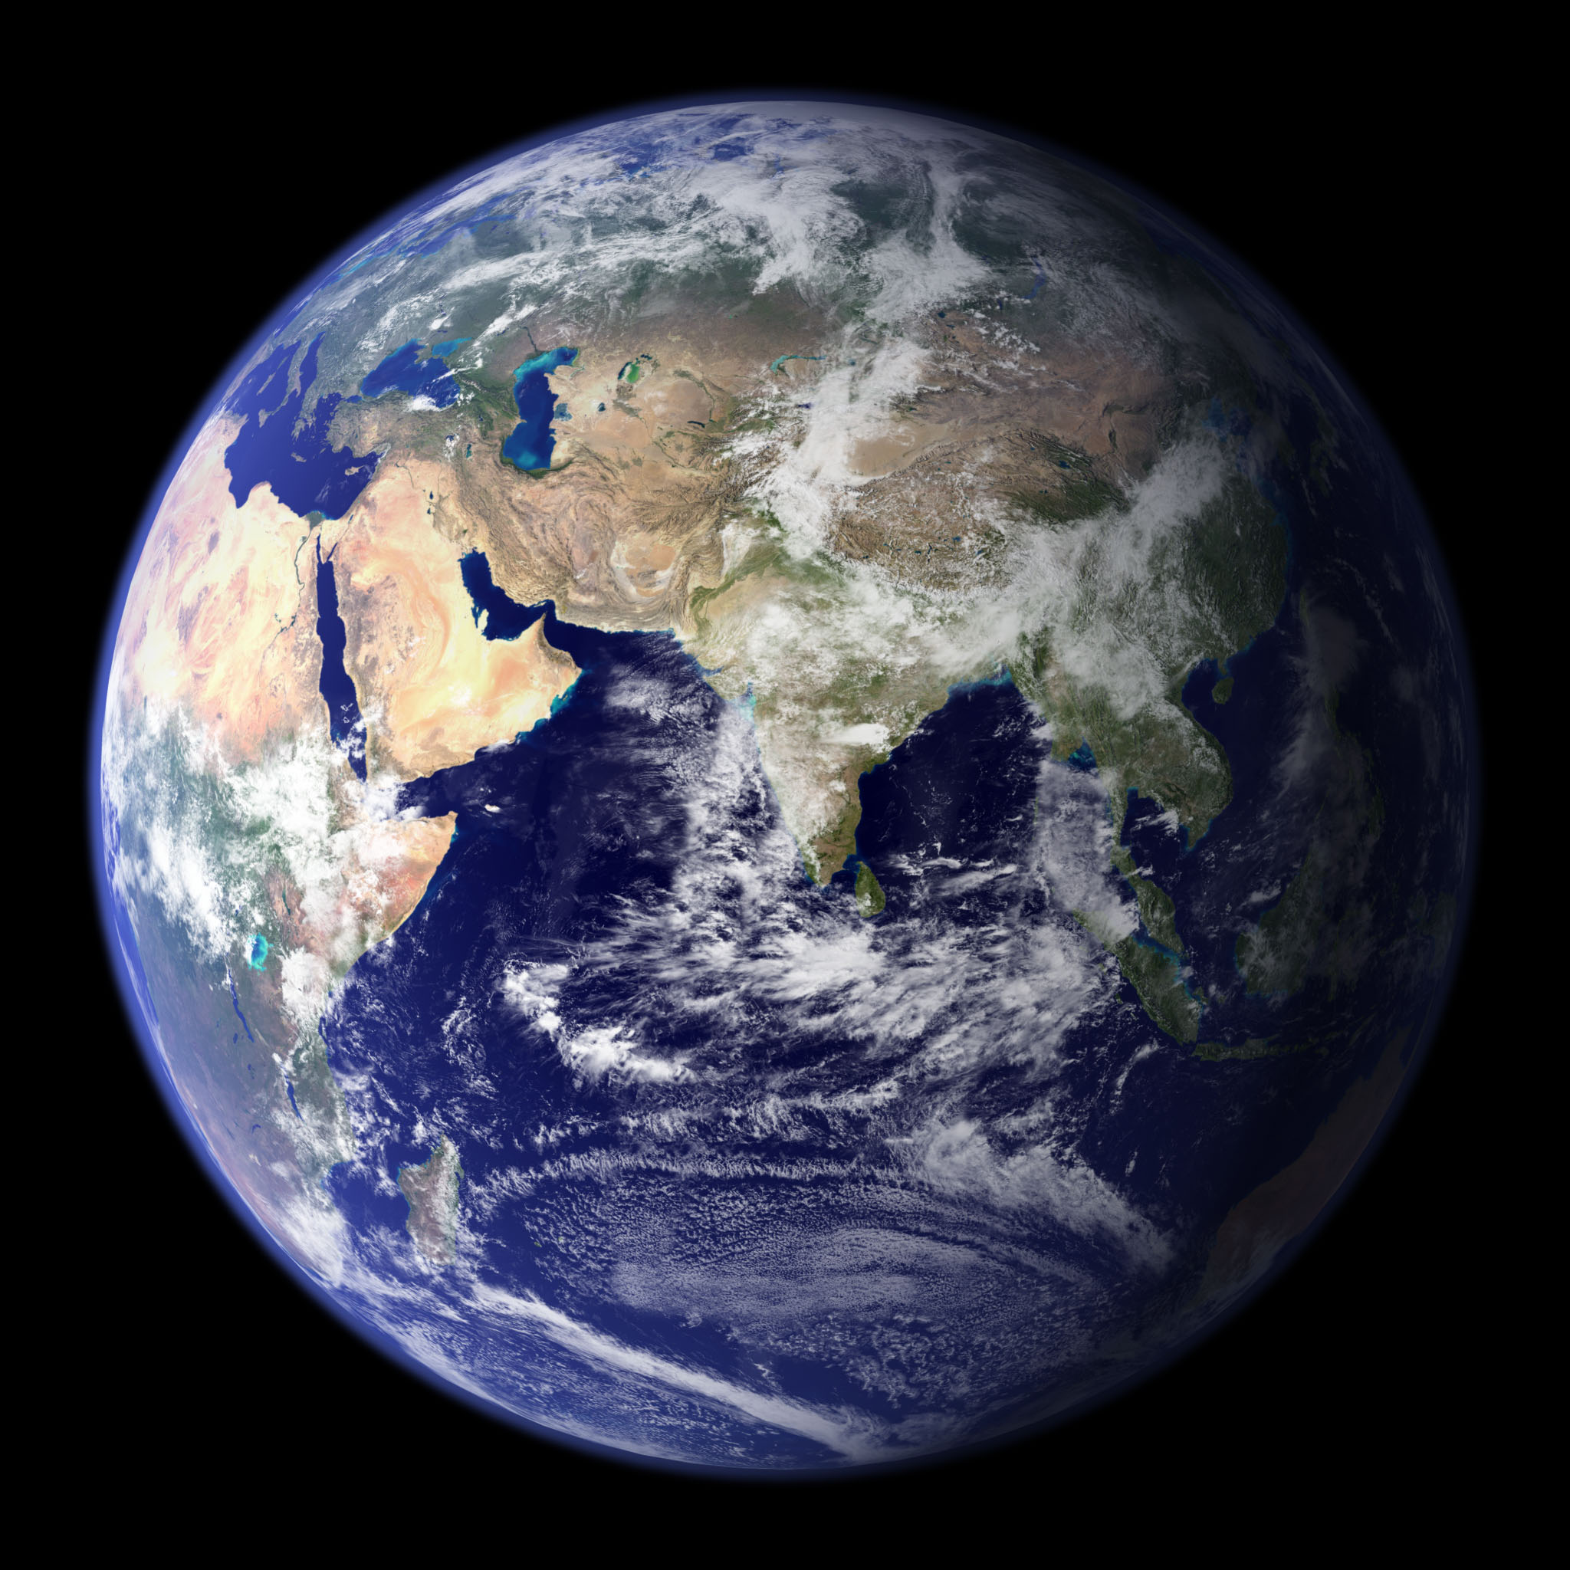
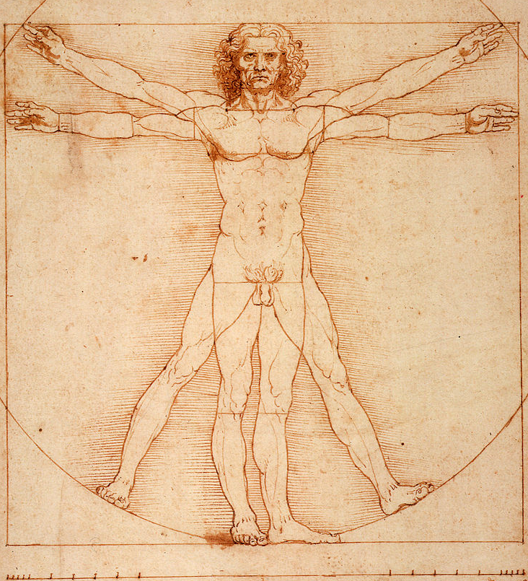
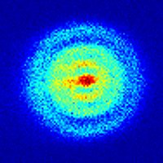
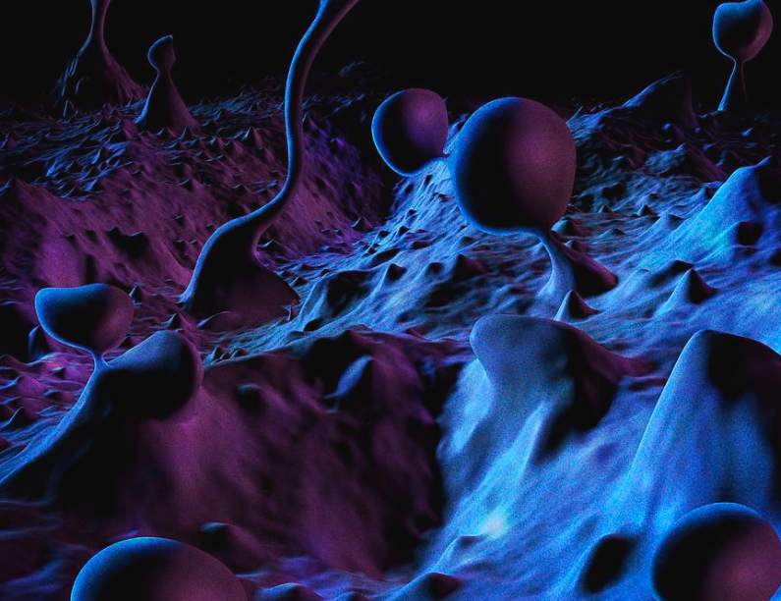
1000^{N} Scale
Universe
Solar System
Cell
Quark
Galaxy
Earth
Hydrogen
Atom
Planck
Length
Humans
10
8
6
4
2
0
-2
-4
-6
-8
-12
Notes:
Photo credits:
-https://www.giantmicrobes.com/us/products/animal-cell.html
http://www.epsnews.eu/2013/06/quantum-microscope/
https://en.wikipedia.org/wiki/Human
Light year: 9 10^15m ~ 10^16
Size of universe 943 billion light years ~ 10^12 light years = 28
Milky way: 105,700 light years = 10^21
Planck Length is 20 powers of 10 smaller than the diameter of a hydrogen nucleus

Slide 4
Energy Moves in Waves
The energy we know is Electro-Magnetic Radiation and includes: light, heat, radio waves, micro-waves and x-rays.
Energy all moves at the speed of light or about:
  186,000 miles per second
  1 billion kilometers per hour
  From the sun to the earth in 8.3 minutes
  1 foot in 1 Nano second (one billionth of a second)

Slide 5
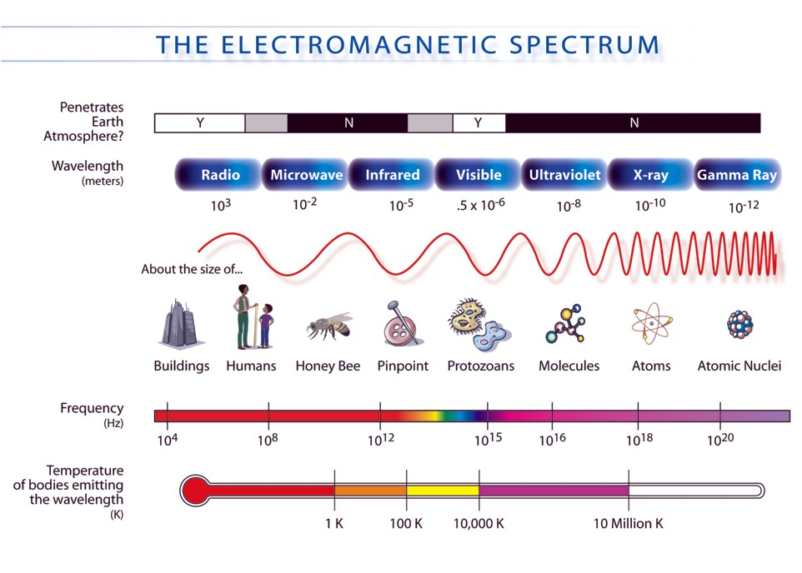

Slide 10
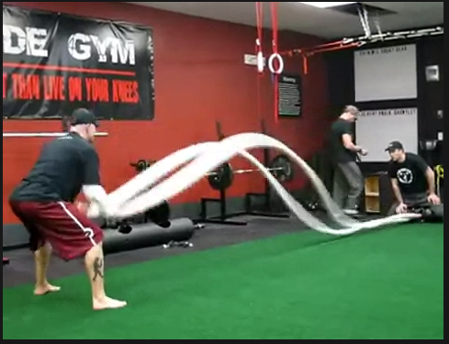
The Universe is Like Jell-O
The “fabric of space” is like Jell-O and energy travels through it like pulses of sound move through the air.

Slide 11
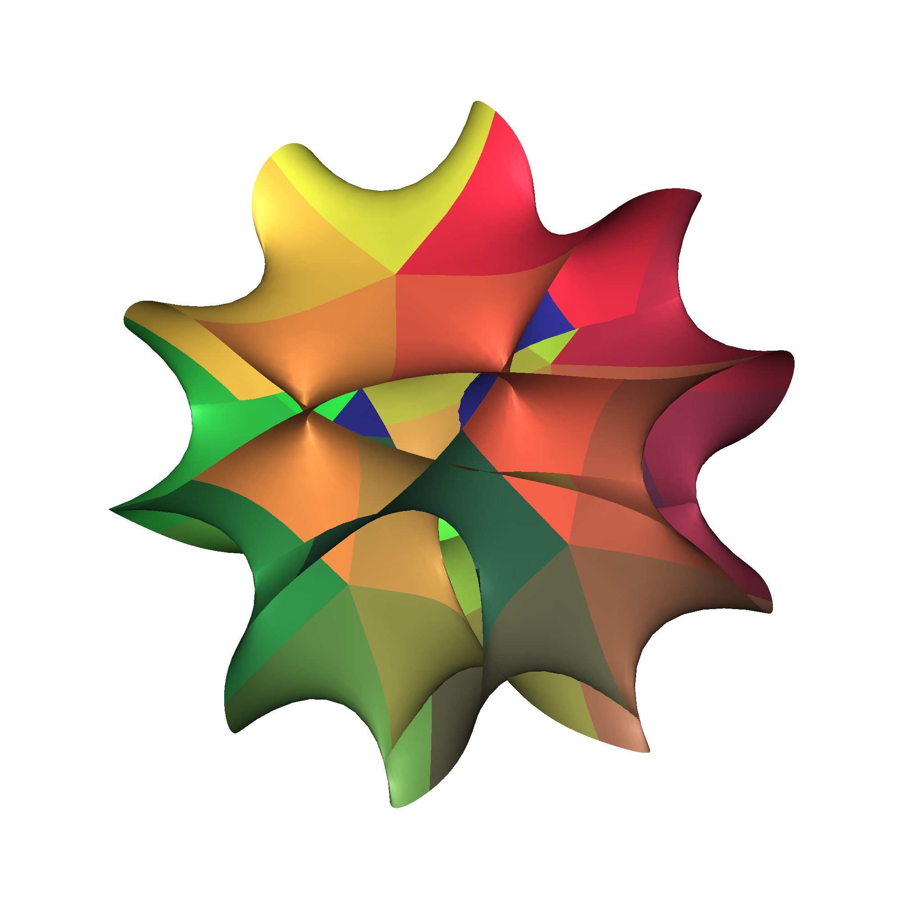
Fabric of Space

Slide 12

Quarks
Energy can be divided until we reach packets of known size:
  $E=\frac{hc}{λ}$ where $h$=Planck constant, $c$= speed of light, $λ$=wavelength
These are called Quarks:
  Photon – light is made up of billions of these
  There are others types of quarks (more on this a little later)…

Slide 13
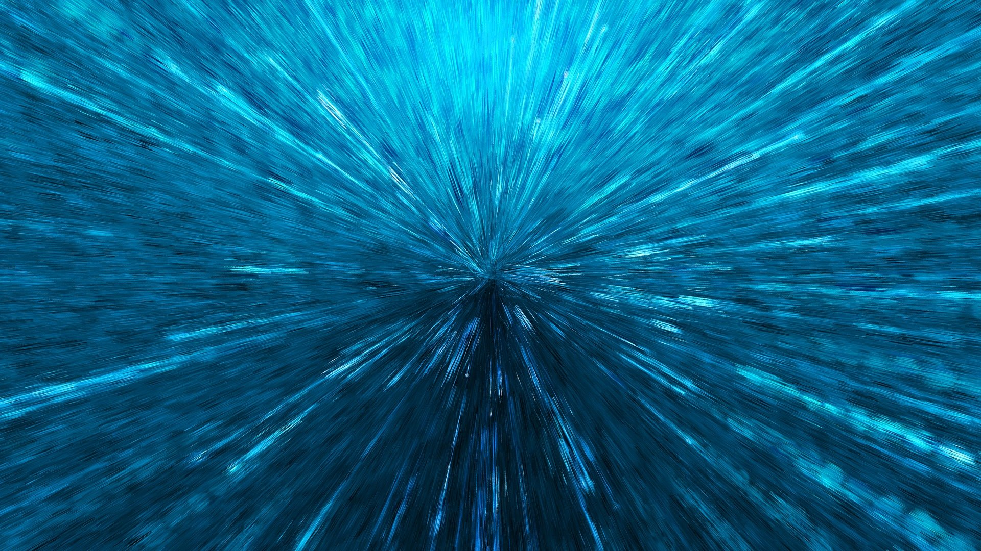
The Big Bang
Notes:
The universe appears to be about 15 billion years old, and is expanding at an increasing rate

Slide 14
The Universe Is Expanding
Red shifts indicated the universe is expanding
Recent observations indicate the universe is increasing its rate of expansion
  Energy repulses other energy
Its like god threw a really big rock in a 3 dimensional lake and the energy is moving outward
  https://www.youtube.com/watch?v=RRPP73QM_4k

Slide 15
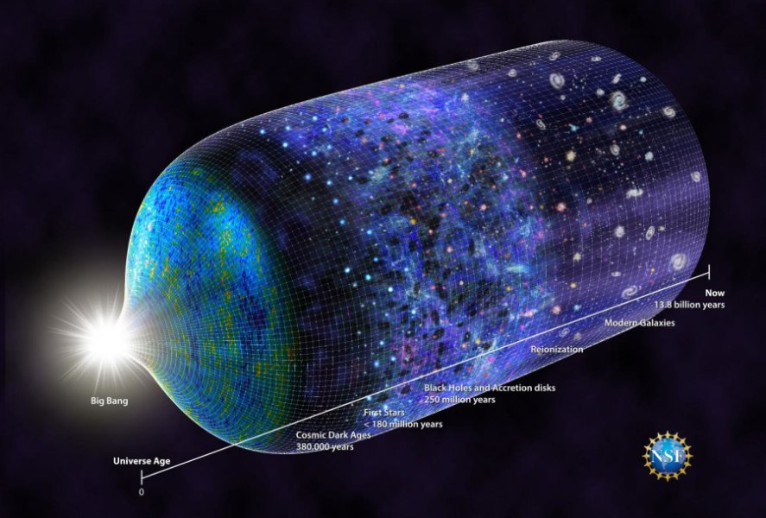
Matter and Forces
Notes:
The universe is increasing it’s rate of expansion

Slide 16
Matter is Energy
Einstein discovered: E=mc²
Energy can be converted into “matter” and back again
  Photons are energy
  Electrons, Up and Down quarks are called “matter” but can be converted into energy
My interpretation:
  There is no matter, only energy moving at the speed of light and energy that is moving much slower or is “trapped” (a.k.a. vibrating)
Notes:
http://animatedphysics.com/insights/particles-of-the-standard-model/

Slide 17
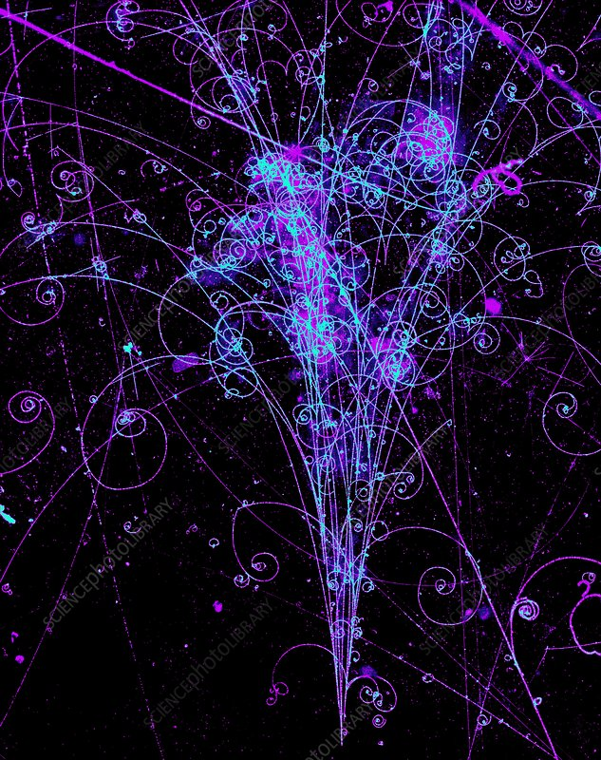
https://www.sciencephoto.com/media/1373/view

Slide 18
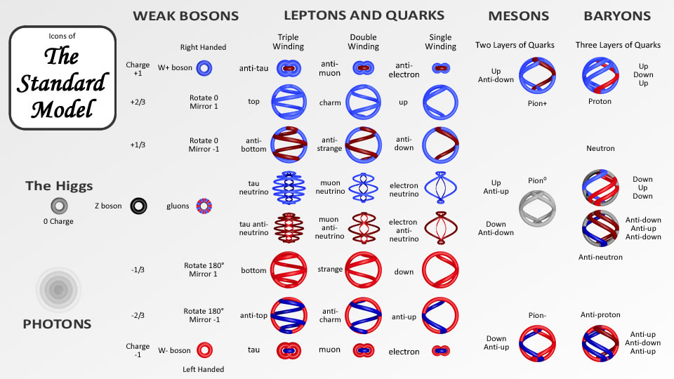
Known Quarks

Slide 19
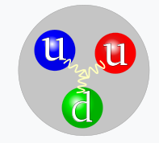
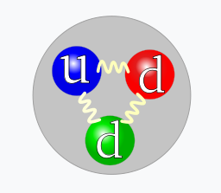
Sub-Atomic “Particles”
Proton’s have two up and one down quark
Neutron’s have two down and one up quark
Proton
Wikipedia
Neutron
Notes:
Matter we know is made of protons, neutrons, and electrons

Slide 20
The Strong Force
Strong
Up
+2/3
Down
-1/3
Up
+2/3
Proton
+1
Down
-1/3
Up
+2/3
Down
-1/3
Neutron
0
Strong

Slide 21
Hydrogen Atom
Up
+2/3
Down
-1/3
Up
+2/3
Proton
+1
Electron
-1

Slide 22
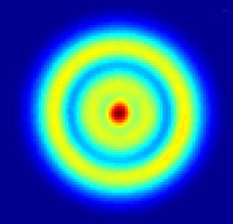
Helium Atom
Up
+2/3
Down
-1/3
Up
+2/3
Proton
+1
Down
-1/3
Up
+2/3
Down
-1/3
Strong
Neutron
0
Up
+2/3
Down
-1/3
Up
+2/3
Proton
+1
Electron
-1
Electron
-1

Slide 23
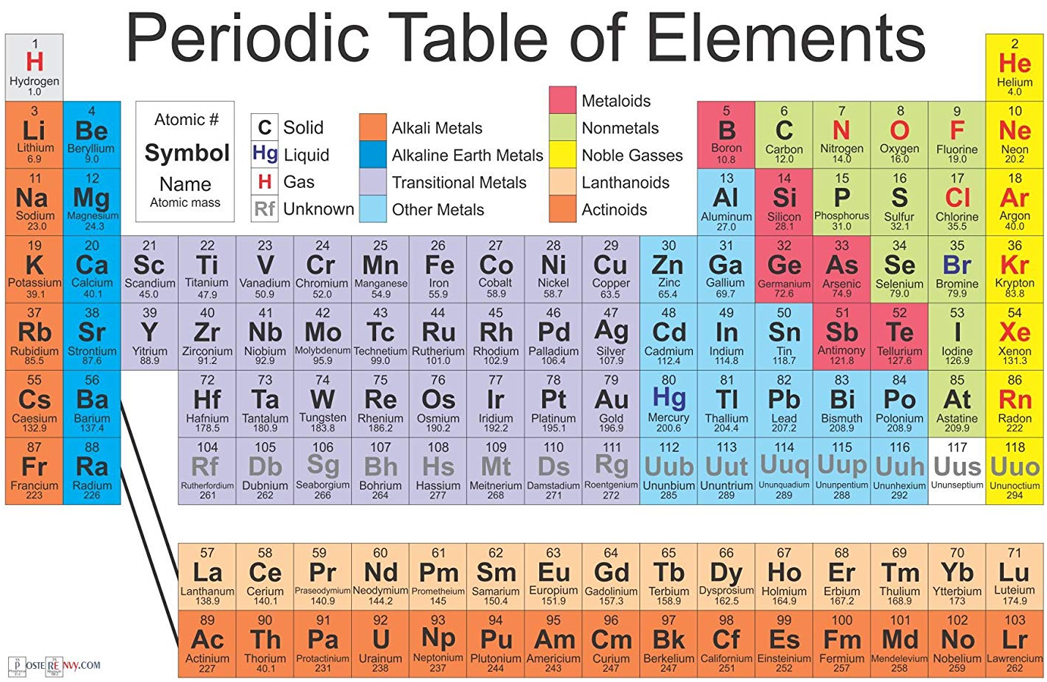

Slide 24
Summary 1
There are quarks (see standard model):
  Photons (a.k.a. EMR): moving at speed of light
  Up, Down, Electrons: moving slower
Sub-atomic “particles” made up of quarks:
  Neutrons and protons
More complex atoms (see periodic table)
Atoms combined together to make molecules (see all of chemistry)
Molecules combined together to make rocks, water, ice, cells, us, planets, etc. (see everything else)

Slide 25
We Know of Four Forces
Each has different effects over difference distances:
Name | Attracts/Repulse | Distance | Strength
Strong Force | Attracts | Short | Strong
Weak Interaction | Attracts | Short | Strong
Electromagnetic | Opposites attract Same repulse | Infinite? | Weak
Gravity | Attracts | Infinite? | Weakest
There is another force in that causes all energy to be repulsed by all other energy
Notes:
At this point we have: quarks (photons, electrons, up, down), sub-atomic particles
We have these forces but we don’t really know what causes them

Slide 26
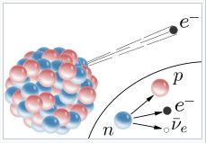
The Weak Interaction
Transforms neutron into a proton, an electron, and an electron antineutrino (Wikipedia)

Slide 27
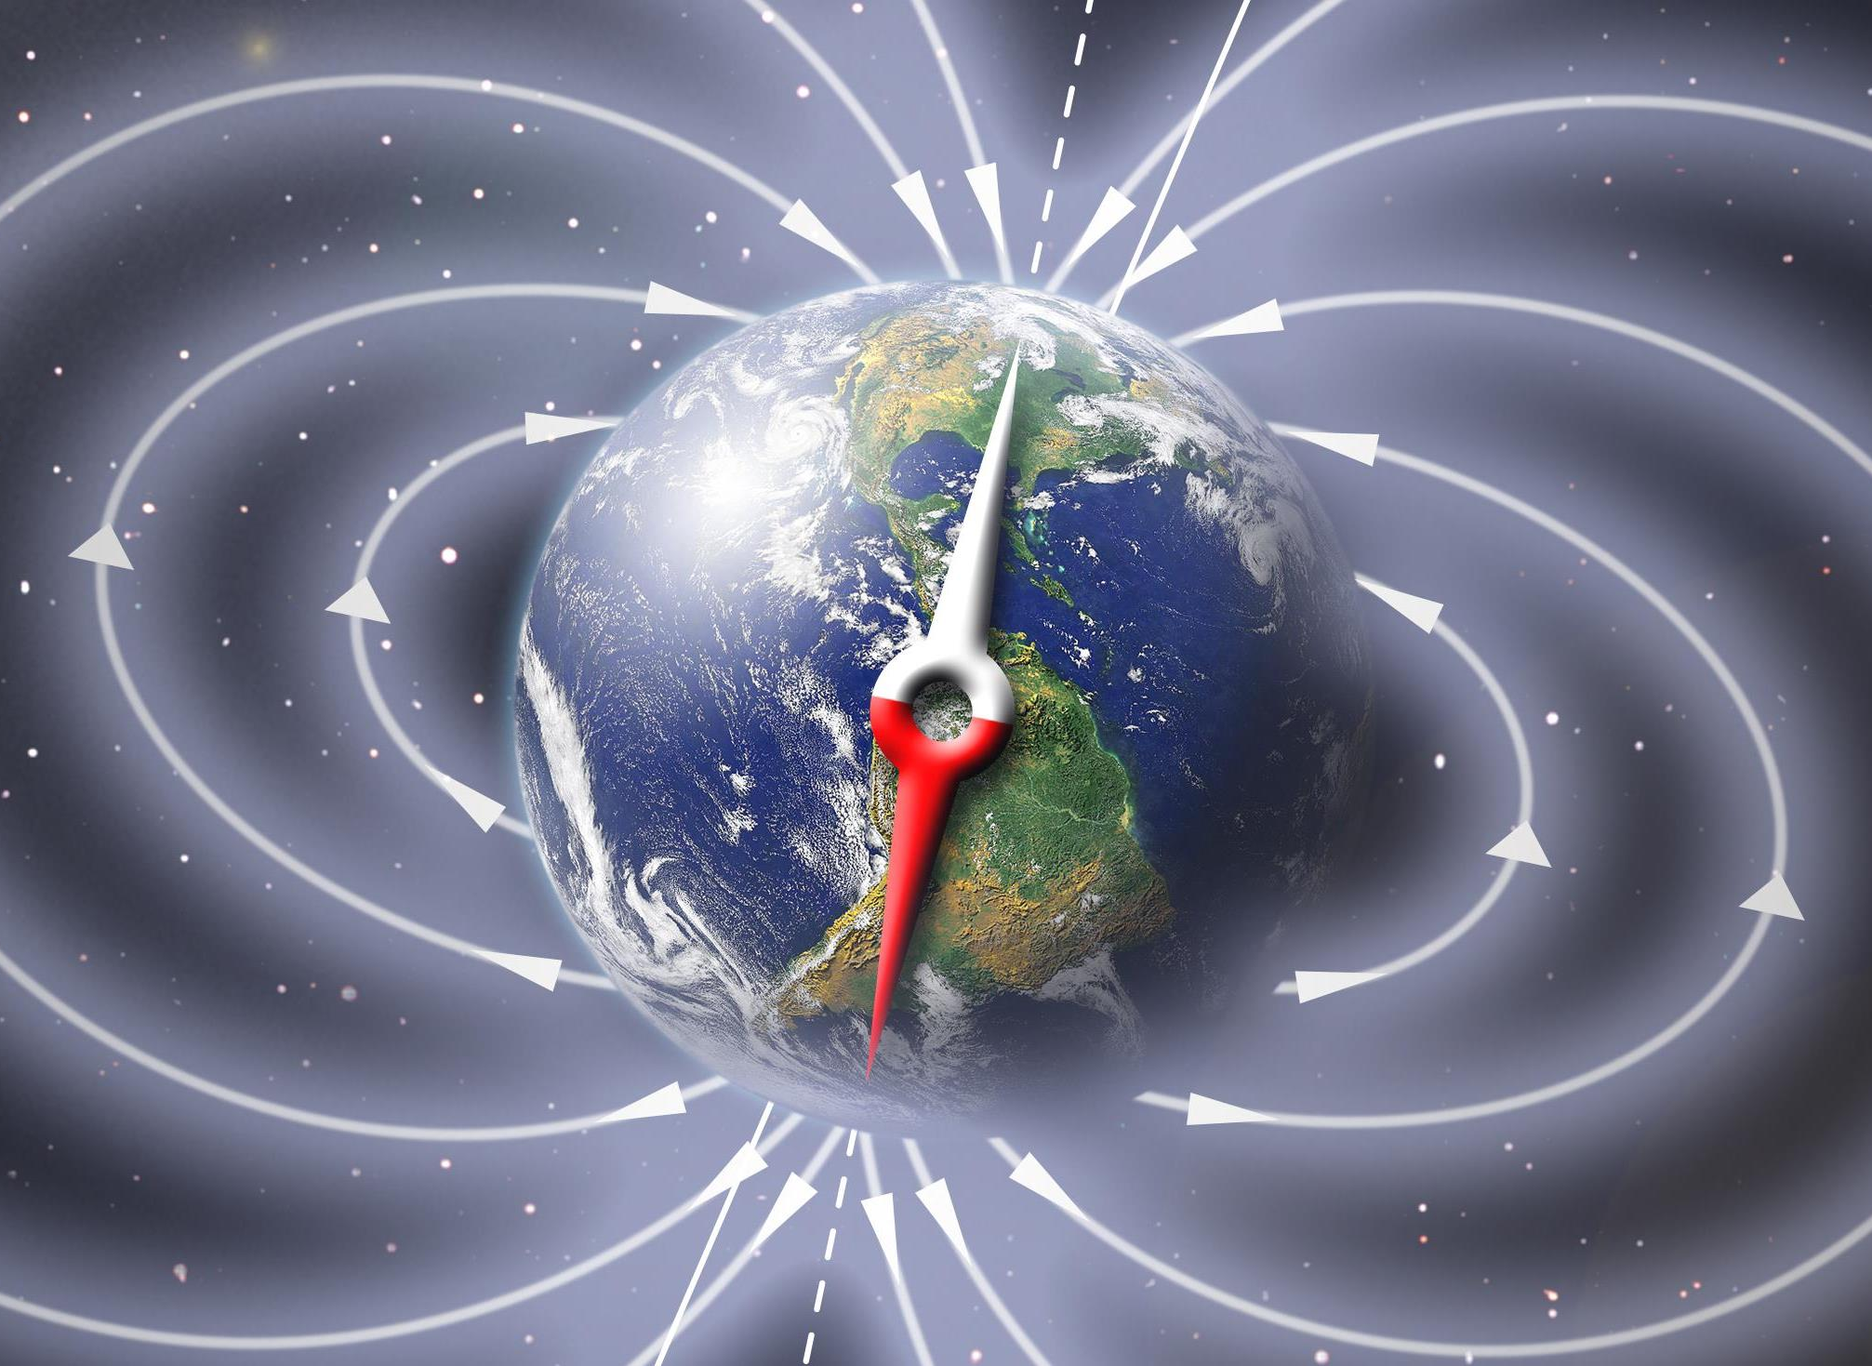
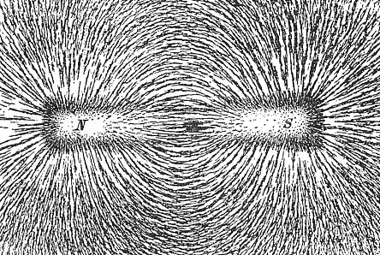
Electromagnetism
When charged stuff moves or are aligned with each other, they create magnetic fields. Similar fields repel while opposite fields attract.

Slide 28
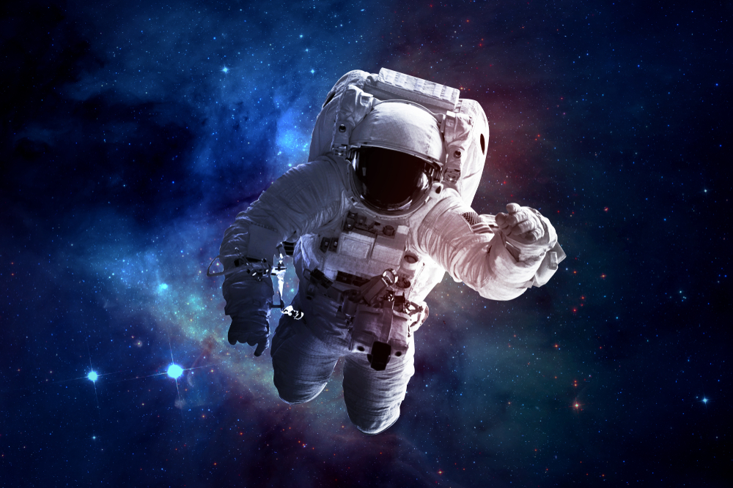
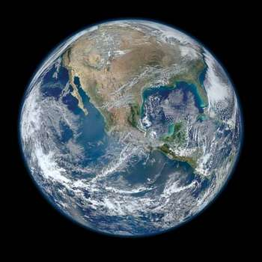
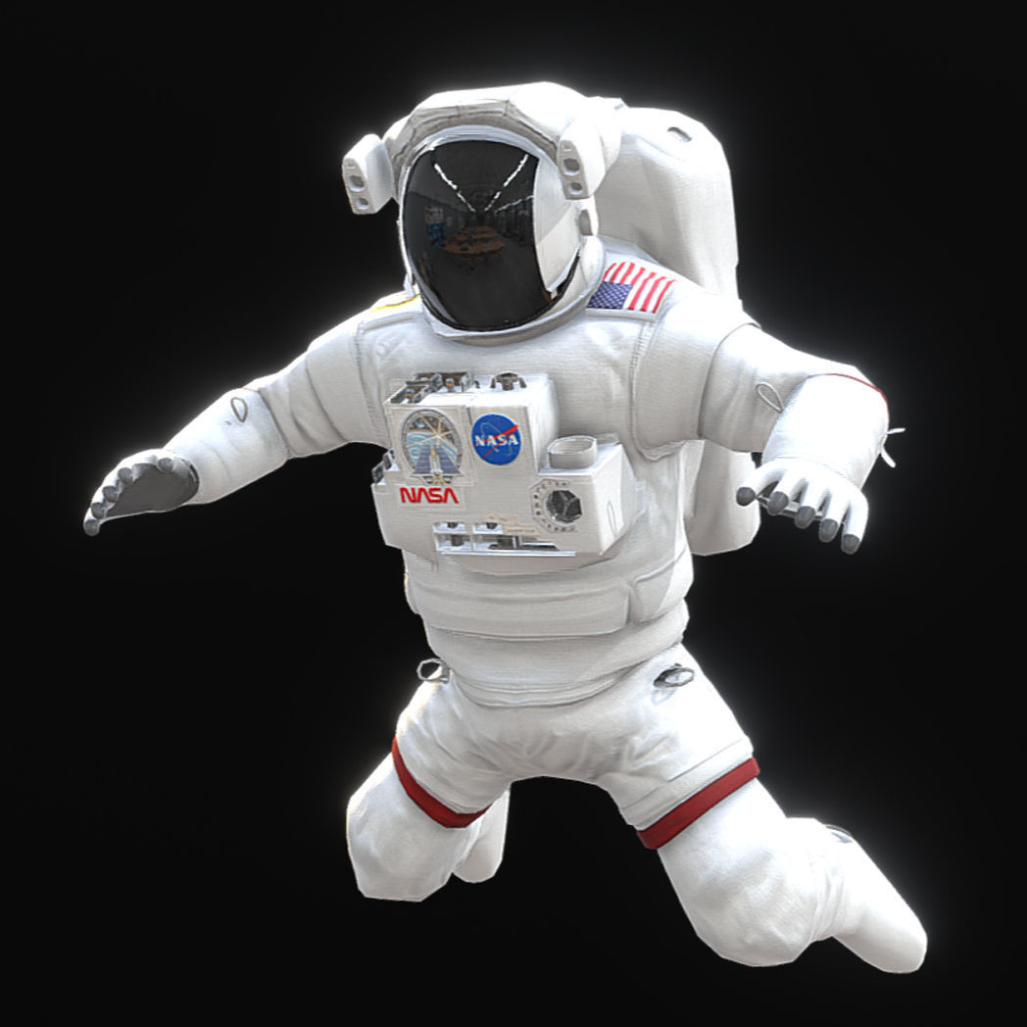
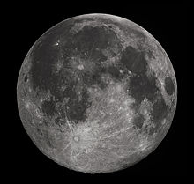
Astronaut in space feels weightless
(0 gravity)
Astronaut on the moon feels 90% lighter than on Earth
Notes:
https://www.cgtrader.com/3d-models/character/sci-fi/low-poly-game-ready-prb-nasa-astronaut

Slide 29
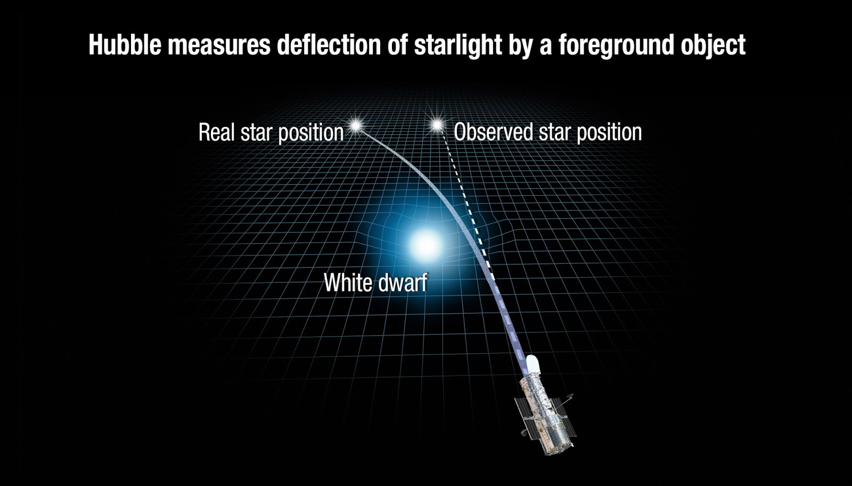
Gravity Bends Light
NASA, ESA
General Relativity
Notes:
Jim’s version: space is more dense where there is matter because the matter is vibrating and thus pulling on the fabric of space
Light then bends just like it bends when it hits glass or water

Slide 30

Gravity and its Cousins
Energy (including matter) moves in a straight line at a constant velocity except:
  All energy is attracted to all other energy proportional to the amount of energy and the distance between them:
    $F=\frac{GM_{1}M_{2}}{r^{2}}$
  Where there is energy (including matter), space is more dense
Related to gravity:
  Centripetal force is similar but proportional to :
    $F=\frac{MV^{2}}{r}$
  Acceleration is also similar:
    $F=MA$
Notes:
Einstein referred to this as bending spaced)

Slide 31
Special Relativity
Free energy moves at light speed no matter what
As a clock increases in speed it will slow down relative to someone that is not moving as fast
Example:
  If you leave the earth and fly at 10% of light speed, when you return to the earth, you will be younger than your twin.

Slide 32
Time and Velocity
Time slows down as speed increases
  Matter cannot reach the speed of light
  Energy moves at the speed of light and does not age

Slide 33
Jim’s Theory
Everything is moving at the speed of light
Free energy moves at the speed of light through space
Trapped energy (matter) vibrates back and forth at the speed of light
  Time passing requires this vibration
  As the speed of matter increases, it cannot move forward faster than the speed of light so it loses time until at the speed of light the vibrations stop as matter becomes energy
When things get really dense, matter can no longer vibrate and there is no change in time

Slide 34
Time and Gravity
Time slows down as gravity increases
  Time slows as density increases
  Time stops when enough matter is squeezed into a very small space (i.e. the Earth into something the size of an atom).
  Density prevents vibrations

Slide 35
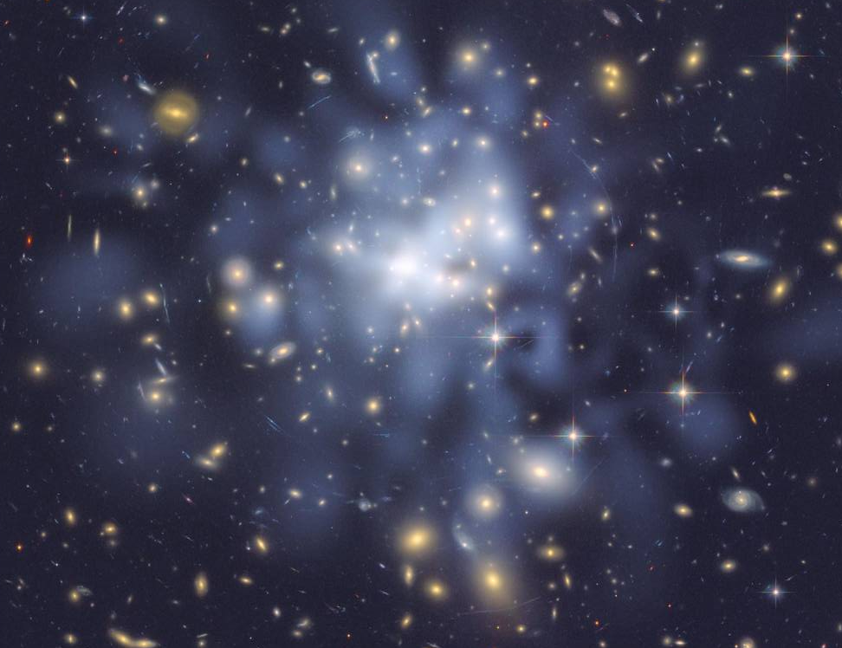
Notes:
NASA, ESA, D. Coe (NASA Jet Propulsion Laboratory/California Institute of Technology, and Space Telescope Science Institute), N. Benitez (Institute of Astrophysics of Andalusia, Spain), T. Broadhurst (University of the Basque Country, Spain), and H. Ford (Johns Hopkins University)

Slide 36
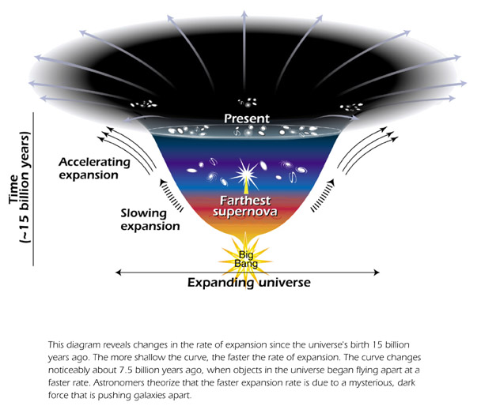
Dark Matter / Dark Energy
NASA
Notes:
¾ of the mass in the universe is dark matter

Slide 37
Summary 2
Current theories based on observation:
  5% matter we can detect
  0.005% EMR
  68% of the universe is dark energy
  27% is dark matter
What if free energy is repulsive and matter is attractive?
  Covers increasing expansion of universe and gravity
  Leaves electromagnetism, strong and weak forces

Slide 38
We Know a Lot, But…
We may figure out:
  Nature of the forces
We will probably never understand:
  How the universe started or how it will end
  The true nature of the fabric of space
  What happens after we die
This leaves us a lot of room for imagination, spirit, and some great movies

Slide 39
Additional Slides

Slide 40
Universe
Globular clusters
Galexies
Solar systems
Planets
Counties
People
People
Cells
Molecules
Atoms
Atomic particles
Quarks
?

Slide 41
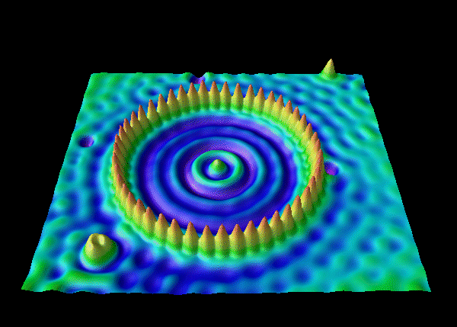
Circle of 48 Iron Atoms on Gold Surface
Notes:
http://www.physicscentral.com/explore/action/atom.cfm
Atoms: 10⁻¹⁰ m
Light waves: 10-6 m (10³ nm)
Proton, neutrons, electrons: 10−15 m
Quarks: 10-18

Slide 42
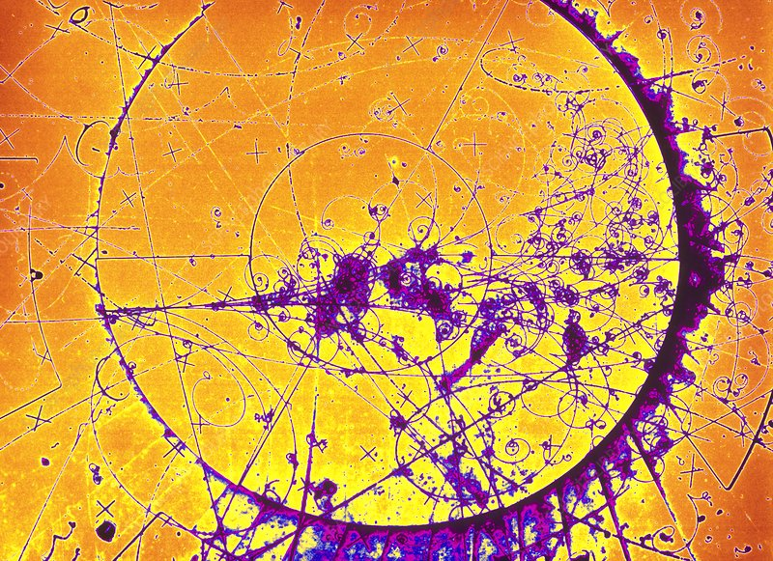
https://www.sciencephoto.com/media/1373/view

Slide 43
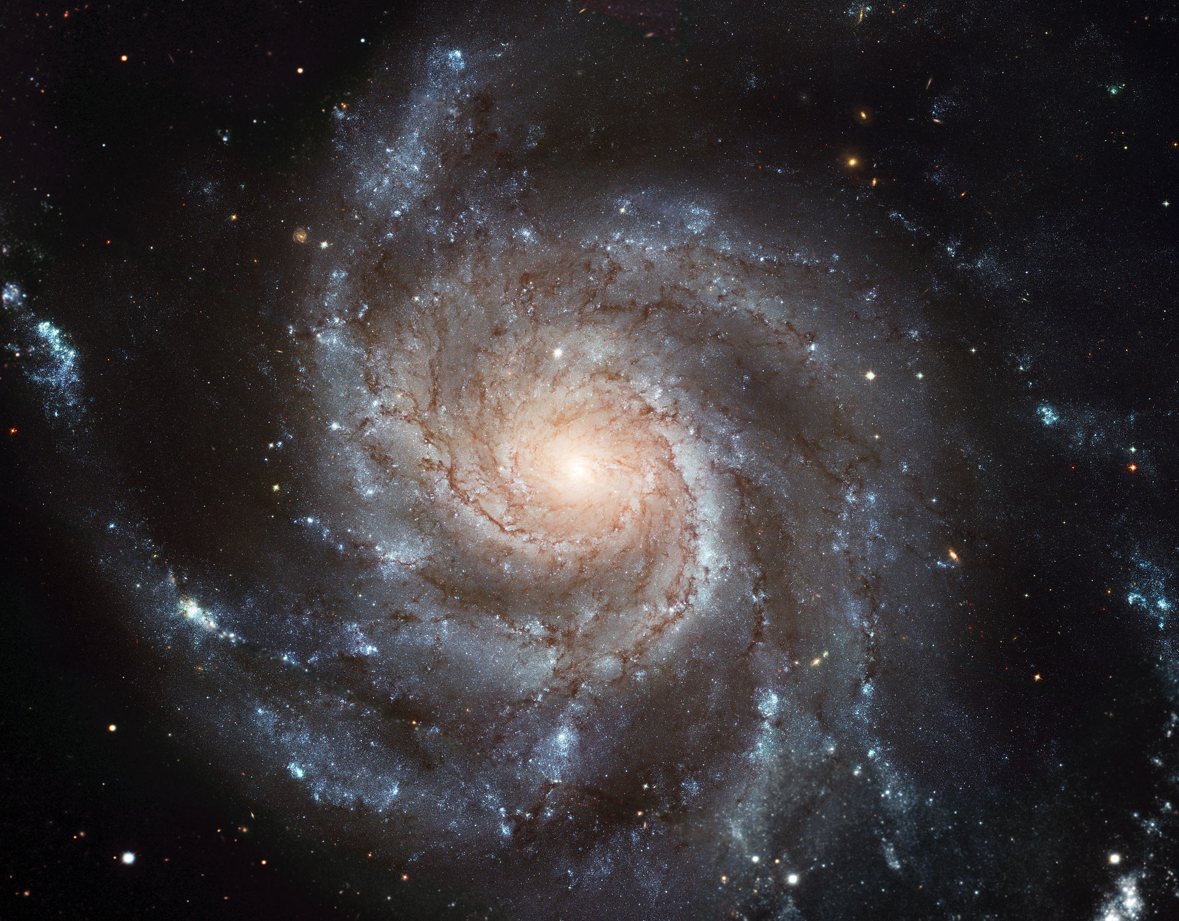
Spiral Galaxy: European Space Agency and NASA

Slide 44
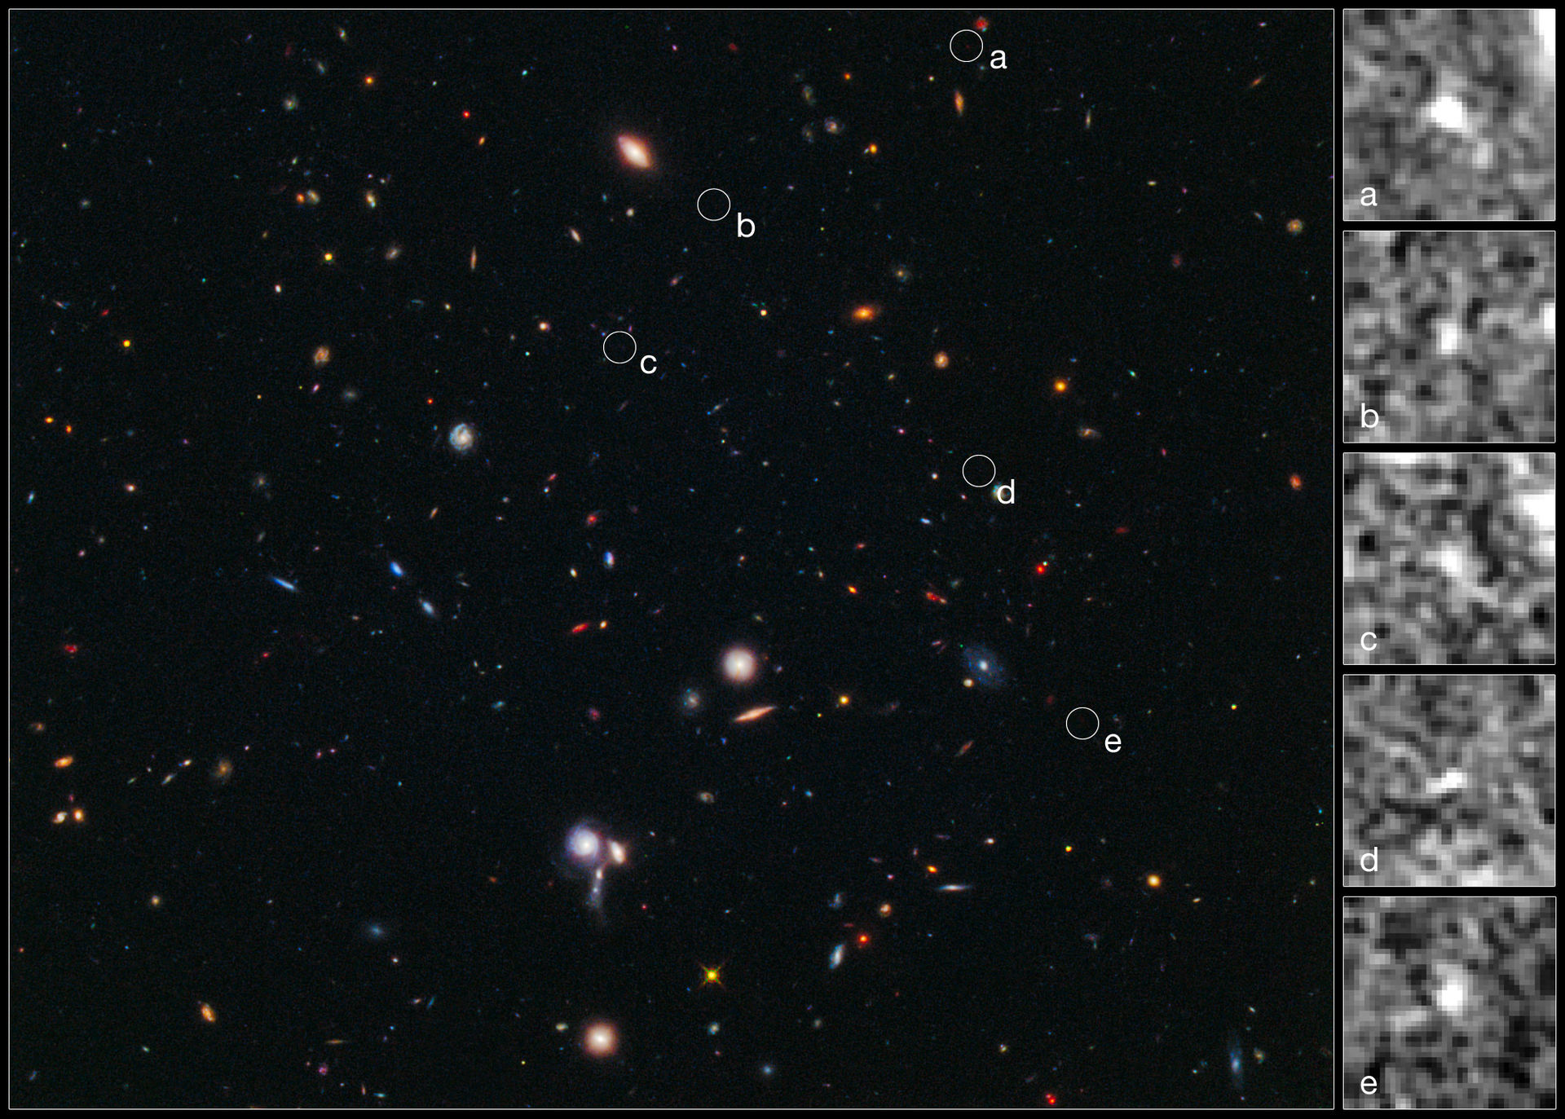
Cluster of Galaxies
Notes:
https://en.wikipedia.org/wiki/Galaxy_cluster#/media/File:BoRG-58.jpg

Slide 45
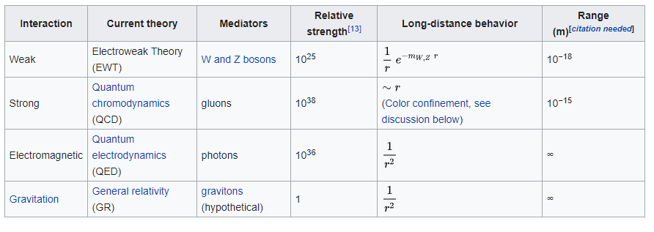
Wikipedia

Slide 46
Gravity
Everything is replusive
When energy is closer, it has sympathetic vibration
Egg in bottle
Bends space

Slide 47
Replusive
Sound canceling?
What if everything repels everything?
  But if you have a different change, you don’t repel as much?

Slide 48
Atomic “Particles” Made up of Quarks
Quarks
Photons
Charge: 0
Mass: 0
Spin: 1
2 Up =
2/3 charge
1 Down =
-1/3 charge
Proton
Charge: +1
Mass: Small
Spin: ½
Electron
Charge: -1
Mass: Small
Spin: 1/2
1 Up =
2/3 charge
2 Down =
-1/3 charge
Neutron
Charge: 0
Mass: Small
Spin: ½
Notes:
Over 95% of the mass in a nucleolus is not the quarks, it is the energy holding the quarks together

Slide 49
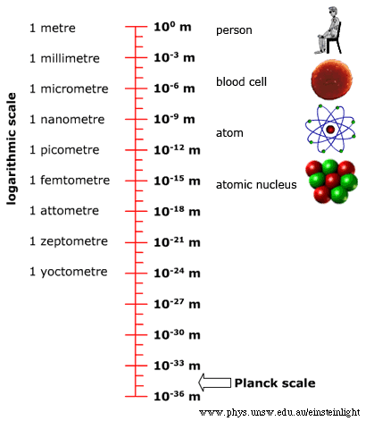
https://newt.phys.unsw.edu.au/einsteinlight/jw/module6_Planck.htm

Slide 50

0.00000000000000000000000000000001 meters

Slide 51
Fabric of Space
0.0000000000000000000000000000000001 meters

Slide 52
Fabric of Space
0.00000000000000000000000000000000001 meters

Slide 53
